Slide 1


International Migration and Employment in Australia
Peter McDonald
Crawford School of Public Policy
The Australian National University
2015 Graeme Hugo Colloquium
Australian Population Association
2 December 2015

Slide 2
McDonald, P. 2015. International migration and employment in Australia. Population Review. 54(2): 1-12

Slide 3
Are migrants getting all the jobs and displacing Australia workers?

Slide 4
Summary
Non-migrant = a person present in Australia in June 2009
Increase in employment, 2009 to 2014
Non-migrants aged less than 55 | -137,000
Non-migrants aged 55 and over | 329,000
Migrants, 2009 to 2014 | 603,000
TOTAL | 795,000

Slide 5
80% of additional jobs from 2009 to 2014 were in seven of the 19 major industry categories (table)
Almost 40% were in Health, Social and Education
Industry | Additional employment 2009-2014 | Annual rate of growth of industry
Health Care and Social Services | 193,000 | 3.0%
Education and Training | 113,000 | 2.6%
Mining | 110,000 | 10.8%
Other Services | 65,000 | 1.4%
Accommodation and Food | 59,000 | 1.6
Administration and Support Services | 54,000 | 2.9%
Rental, Hiring and Real Estate | 48,000 | 4.7%
TOTAL | 795,000 | 1.4%

Slide 6
932,000 migrants and older people got the jobs but did they force more Australians into unemployment?
Note: the numbers in the table may include unemployed migrants as well as non-migrants
Change in Unemployment of Persons Seeking Full-time Work: 2009-2014
Men aged less than 55 | -10,700
Women aged less than 15-34 | 4,500
Women aged 35-54 | 17,400
TOTAL (aged less than 55) | 11,200

Slide 7
Summary
Unemployment is not about Australians losing out in competition with migrants (or with older Australians).
Unemployment is about the skill levels of unemployed people and it is a long-term issue. The same numbers of unemployed were there five years ago before the migrants came. Blaming migrants draws attention away from the real issue.
Notes:
We might equally blame older Australians but that would be politically incorrect compared to the easier target of blaming migrants.

Slide 8
Do international students and working holiday makers push young Australians into unemployment?
Persons Aged Less than 25 , June 2014 | Number
Unemployed and looking for full-time work, not in full-time education | 129,000 84,000 males 45,000 females
Employed part-time (may include international students & WHM) | 940,000
International students | 340,000
Working Holiday makers | 151,000
The nature of work at young ages has changed. In 1984, 80% of
employed 15-24 year olds worked full-time compared with 47% in
2014. Full-time work in these ages, especially for men, has
become increasingly selective of blue collar work. This is not
the job market occupied by students and working holiday makers.

Slide 9
Do migrants have an advantage over newly-qualified Australian professionals?

Slide 10
This is a more relevant question
The issue is that migrants with 5-10 years of experience will normally be better skilled for positions in Australia than recent Australian graduates.
Fields where this may occur are academia, nursing and IT. On the basis of the selection criteria, the migrant is undoubtedly better qualified.
  What weight should be given to the notion of international labour markets?
  Do the migrants have a commitment to Australia and an interest in Australian issues?
The long-term interests of these industries need to be cognisant of investing in the young Australian graduate.

Slide 11
Academics

Slide 12
Do migrants provide a demographic bonus by increasing the proportion of the population in the labour force ages?

Slide 13
Population outcomes for Australia with varying levels of net overseas migration
Level of Net Overseas Migration | Per Cent of Population Aged 15-64, 2053 (%) | Per cent of Population Aged 65 and Over, 2053 (%)
0 | 56 | 28.4
100,000 | 58 | 25.2
180,000 | 60 | 23.4
300,000 | 62 | 21.2
Current level | 67 | 14.0

Slide 14
Labour force outcomes for Australia with varying levels of net overseas migration
Migrants assumed to have Australian labour characteristics

Slide 15
GDP per capita growth rate
under different levels of net overseas migration
a
Migrants have same productivity
as other Australians: 1.6%
Migrants have higher productivity
than other Australians: 2.0% v 1.6%

Slide 16
New permanent migrants are increasingly sourced from among temporary migrants

Slide 17
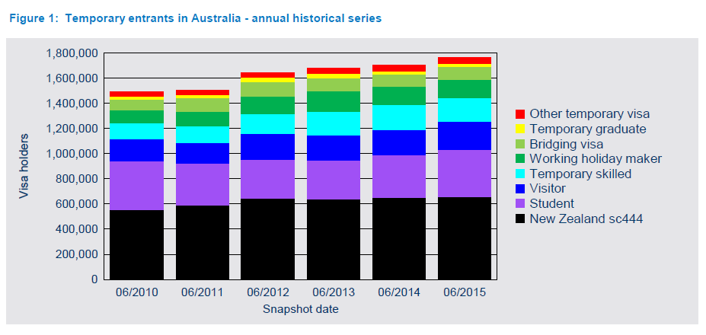

Slide 18
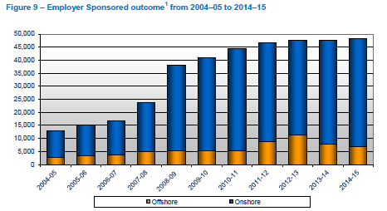

Slide 19
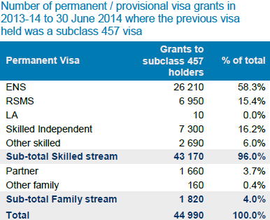
Conversions from 457 to PR:
‘try before you buy’

Slide 20
Conclusion
Growth in employment in Australia is contingent on the recruitment of skilled immigrants and the 457 visa now plays the central role in this process.
Lifting the shackles on the 457 visa while improving its integrity is important to the health of the Australian economy.
John Azarias, Jenny Lambert, Peter McDonald and Katie Malyon. 2014. Robust New Foundations: A Streamlined, Transparent and Responsive System for the 457 Visa Programme. Available from the Department of Immigration and Border Protection, Canberra.

