Slide 1
Australian Population Association Graeme Hugo Colloquium ANU, 2nd December 2015 Graeme Hugo on Population Ageing Don Rowland Formerly Associate Professor in Population Studies School of Sociology, ANU

Slide 2
Presentations on Population Ageing
1980-1989 | 15
1990-1999 | 8
2000-2009 | 43
2010-2014 | 34
Total | 100

Slide 3
Presentations on Population Ageing
1980-1989 | 15
1990-1999 | 8
2000-2009 | 43
2010-2014 | 34
Total | 100
Geographical Focus of Presentations
Australia | 54
South Australia | 32
World regions* | 14
Total | 100
*especially Asia

Slide 4
Theme: the ageing of the baby boomers
“…the baby boom may now be entering a period where it will cease to be labelled as troublesome. The final years of the 1980s will see the last of the baby boomers pass out of the ‘difficult’ ages … Of course such optimism should be tempered by the knowledge that the baby boomer generation will begin to enter the pensionable ages a decade into the next century.”
(Hugo 1986: Australia’s Changing Population, p.159).
Outline
Building the baby boom generation
Generational differences
Labour force participation
Health

Slide 5
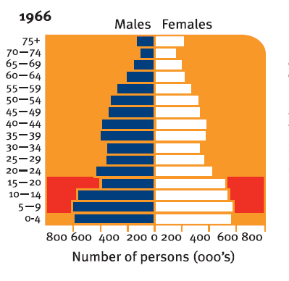
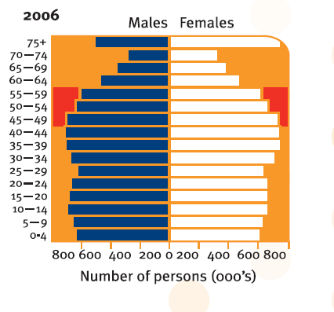
Australia, Age Structures, 1966 and 2006
Source: Hugo et al. 2008: The State of Ageing in South Australia, p.38

Slide 6
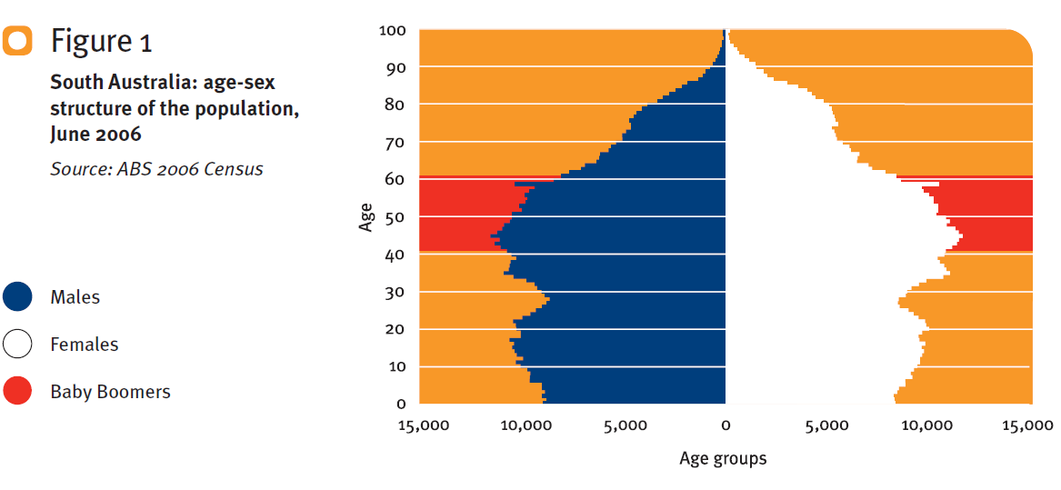
South Australia, Age Structure 2006

Slide 7
Percentages aged 65 and over
in South Australia and Australia
 | South Australia | Australia
2006 | 15.1 | 13.3
2031 | 23.9 | 18.7

Slide 8
ABS (2013) Projections for ages 65+ Australia 2031
 | Millions | Percentages of the total population
Series A | 5.83 | 18.3
Series B | 5.71 | 18.7
Series C | 5.69 | 19.4
“The crucial point … is that there is really only one realistic scenario with respect to the future numerical growth of Australia’s older population.”

Slide 9
Generational differences
More diverse than older cohorts
A segmented market
First to experience high rates of divorce
Higher proportions childless
Higher proportions living alone
More overseas-born
Source: Hugo 2014, with acknowledgment to Jennifer Buckley.

Slide 10
Labour force experience of baby boomers in South Australia
Higher labour force participation
Early retirement declining
Potential to extend working life
Older women in the labour force
“The culture of early retirement, previously so pervasive, is being replaced by a culture of gradual retirement, encompassing continued part-time employment. An important finding of this study is the large number of Baby Boomers who will be happy to work part-time or never retire.”

Slide 11
Health of the baby boom generation
Healthier
Grew up in a time of greater prosperity
Higher levels of educational attainment
First with immunisation and anti-biotics
Lower levels of smoking
Less healthy
‘Rescued’ from death, more chronic illness
More likely to have 3 or more health problems
‘Spatial disadvantage’ in access to health services
More diabetes, asthma and high cholesterol
More overweight or obese

Slide 12
Conclusion
“We can be very certain about the future size of this population, many of the characteristics of the future aged population are also fixed and many are currently living where they will be living when they enter old age. There are some uncertainties and these will strongly be influenced by policy interventions.”

